Slide 1
Pathway and network analysis
(Ways to interpret biological data)
Amin Momin
McCombs Institute for the Early Detection and Treatment of Cancer
MD Anderson cancer center
INTRODUCTION TO BIOINFORMATICS
December 6nd 2016

Slide 2
Next generation sequencing based assays
Whole exome, genome, RNAseq, microRNA seq, ncRNA
Others: Methylation, ChipSeq
Non-sequencing based assays
Proteomics, metabolomics, siRNA knockout, RPPA, drug
screening assay

Slide 3
Standard analysis workflow
Obtain the data
Normalize
Identify altered genes, proteins and other molecules (probably phenotype)
Graphical representation of the data

Slide 4
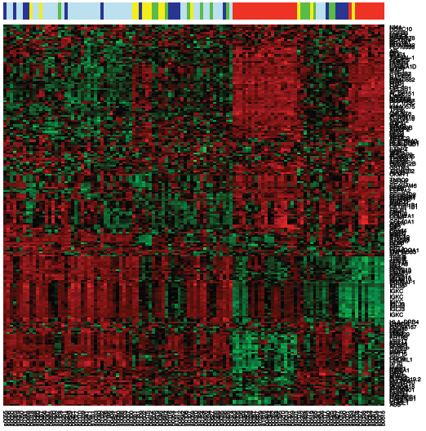
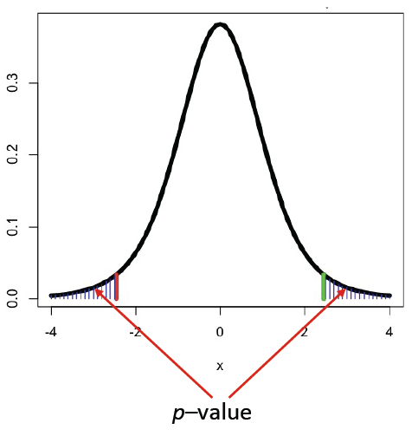
Gene expression analysis
Ken Chen’s slide

Slide 5
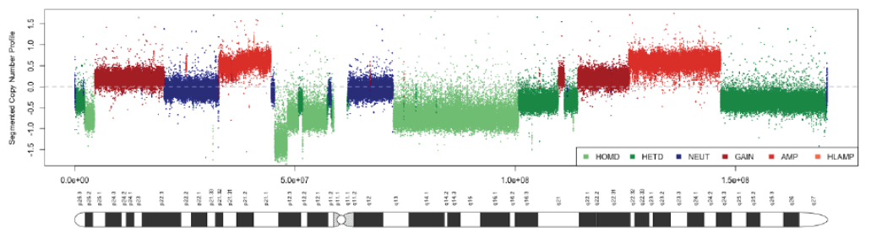
Copy Number segmentation
Ken Chen’s slide

Slide 6
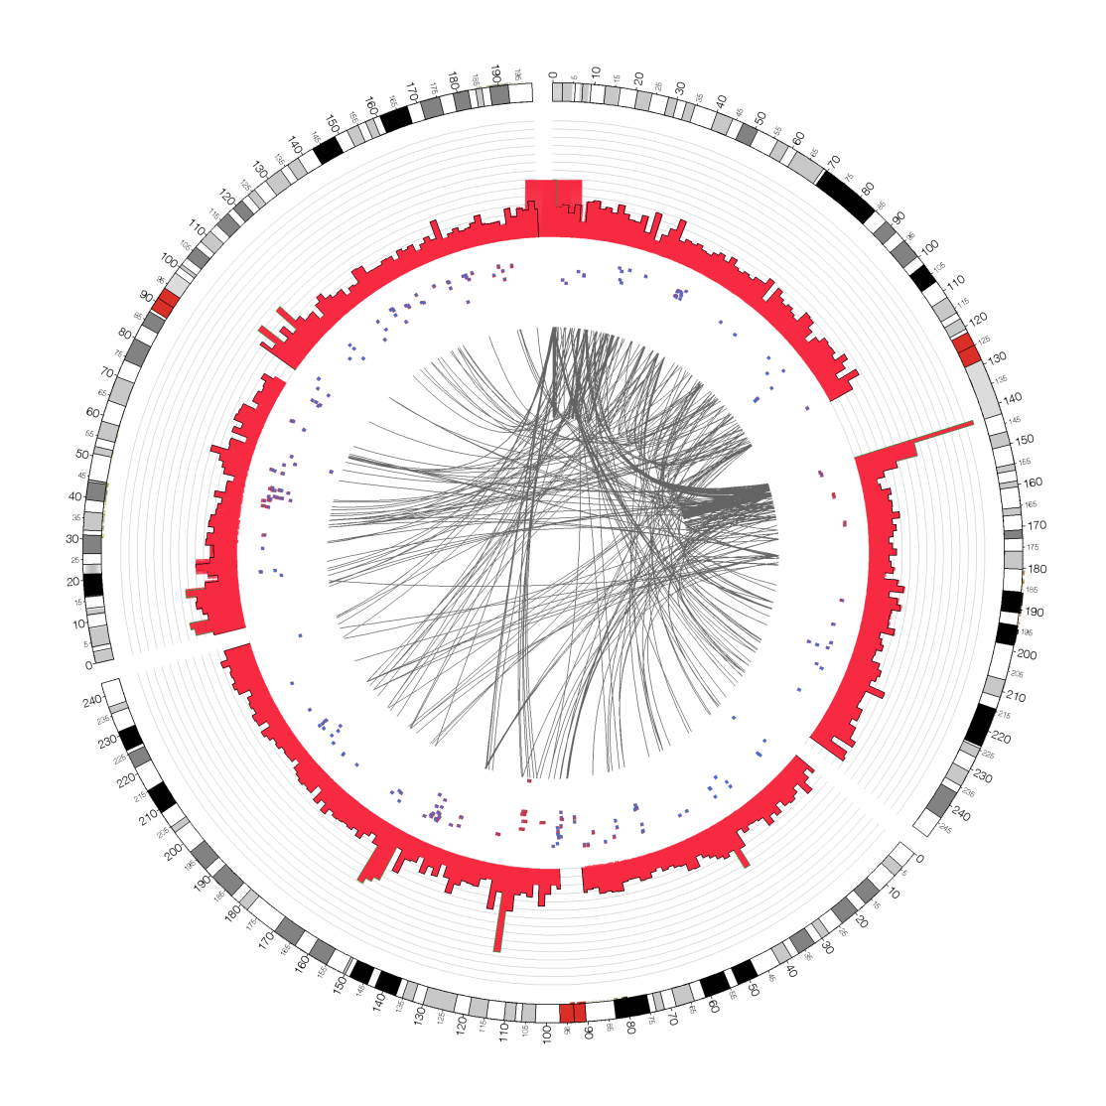
Circos plots for sequencing studies

Slide 7
Does this explain the biology behind the changes ?
Probably Not ☹

Slide 8
Growing trend
Perform “biological interpretation” on omics datasets
Integrate diverse platforms
Visualize results in meaningful format

Slide 9
Challenges
Unfeasible to manually connect relationships between 100-1000’s of data points
Genes and other molecules don't work independently
Interpretation of results is influenced by the biological
context

Slide 10
How does one address this ?

Slide 11
Two common approaches
Pathway Maps : They are predefined relationships based on
previous knowledge. Maps have a well defined (consensus) structure.
Information is usually obtained from a single database / repository.
Example: Signaling pathway, biochemical pathway, disease specific
Pathways (KEGG, BioCarta, Reactome, etc)
Biological networks : Constructed de novo based on the types
of information measured, context of the experiment and nature of
knowledge database employed. Combine information from multiple
sources, both experimentally validated and predicted.
Example: TF regulatory networks, epigenetic regulation, miR- mRNA
networks, gene metabolite networks (STRING-DB, miRbase, tarbase,
ENCODE, Transfac, other pathway databases mentioned above)

Slide 12
Popular Pathway Analysis Resources
Ingenuity Pathway Analysis (Ingenuity Systems)
MetaCore (Thomson Reuters GeneGo)
DAVID (open source)
GenMapp/Pathvisio (UCSF)
Cytoscape (ISB/UCSD)
Reactome (OICR/NYGenome/EBI)

Slide 13
Some examples

Slide 14
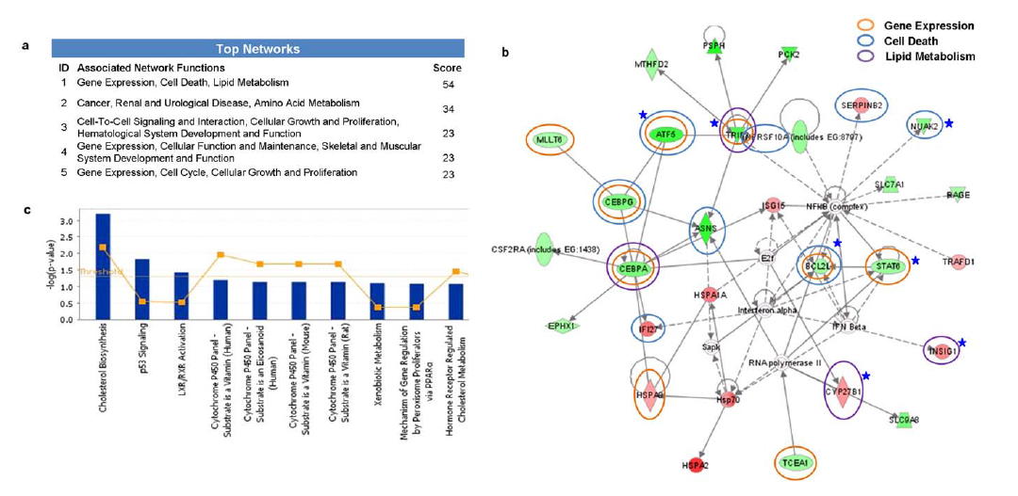
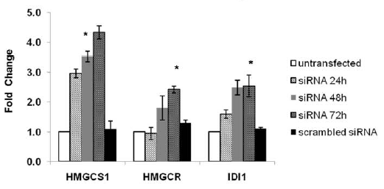
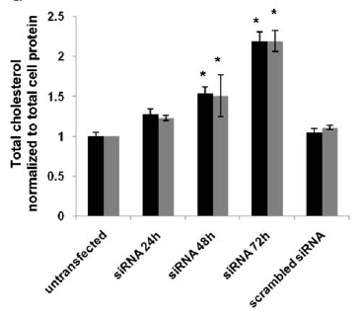
siRNA against STAT6 leads to increased
cholesterol synthesis in Lung cancer cell lines
Dubey et al; PLoS One. 2011;6(12)

Slide 15
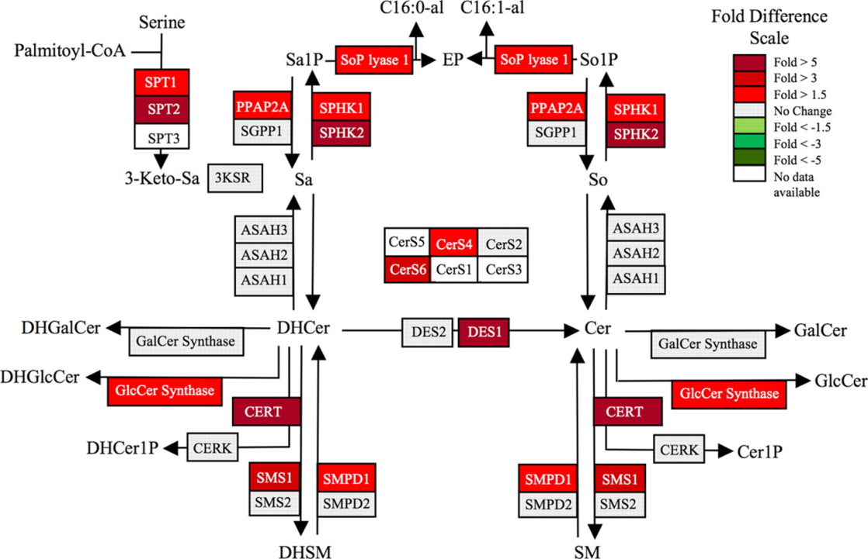
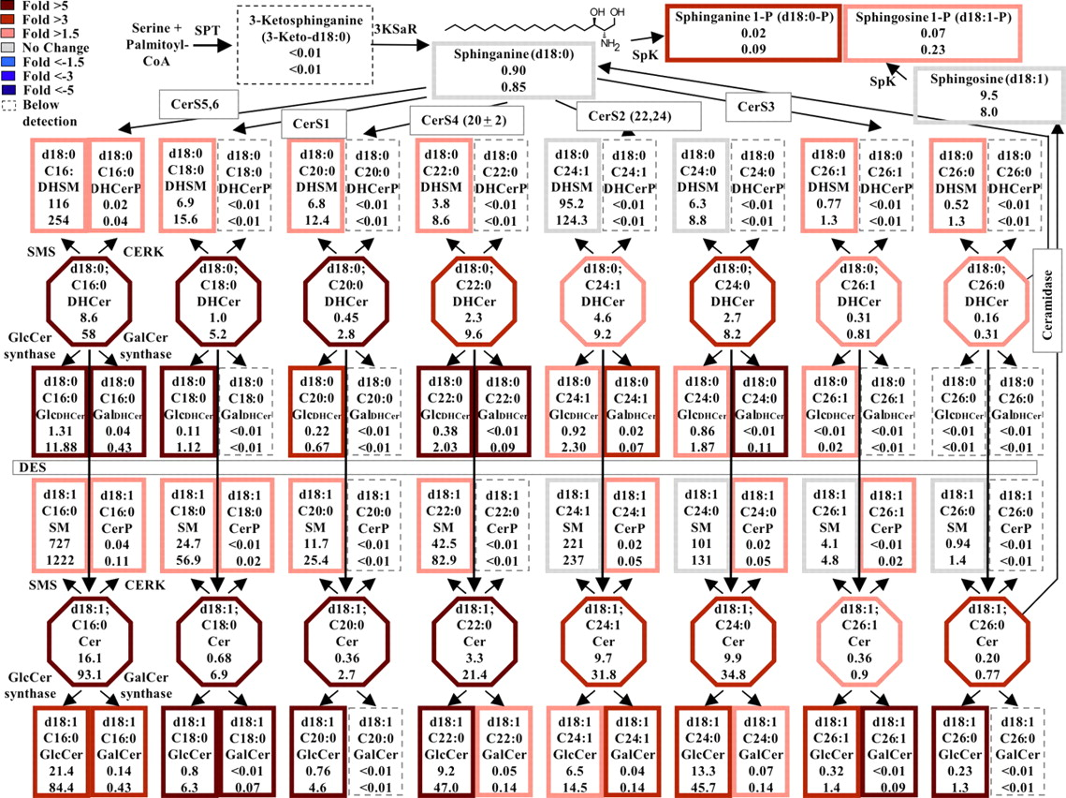
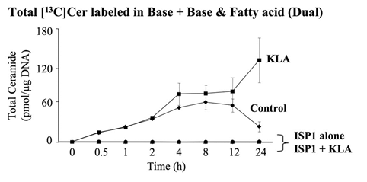
KLA induces substantial increases in the amounts of multiple cellular sphingolipids.
Sims K et al. J. Biol. Chem. 2010;285:38568
Notes:
KLA induces substantial increases in the amounts of multiple cellular sphingolipids. RAW264.7 cells were incubated with vehicle control (PBS) or KLA (100 ng/ml). Following 24 h of treatment, cells were harvested for lipid extraction and analysis by LC ESI-MS/MS. The number of million molecules per cell for each sphingolipid species is shown for control (upper number) and KLA (lower number)-treated cells with heat map coloration to illustrate the fold change of each subspecies. Data represent the means (n = 9).

Slide 16
Caveats
Pathways from different sources vary Eg KEGG,
Wikipathways, NCI pathways
Pathway nomenclature differ between resources
Databases and maps are updated regularly; may alter
results
Use of different statistical tests; fishers exact test, z-scores,
heuristic filter
Resources are biased towards well studied areas

Slide 17
Ingenuity pathway analysis – Core analysis
(Canonical pathways)
Preparation of data
Upload of dataset
Setting up core analysis
Looking up the results
- Summary
- Canonical pathways
- Network
- Biological processes
- Upstream regulators

Slide 18
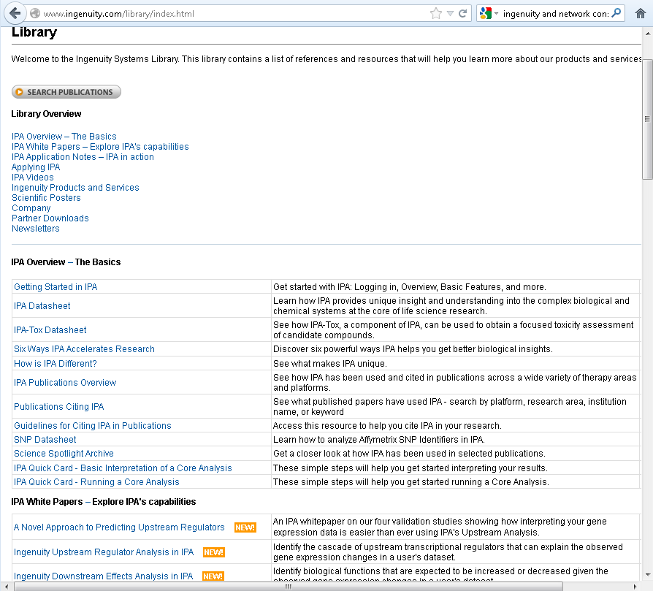
IPA Help
Page
http://www.ingenuity.com/library/index.html

Slide 19
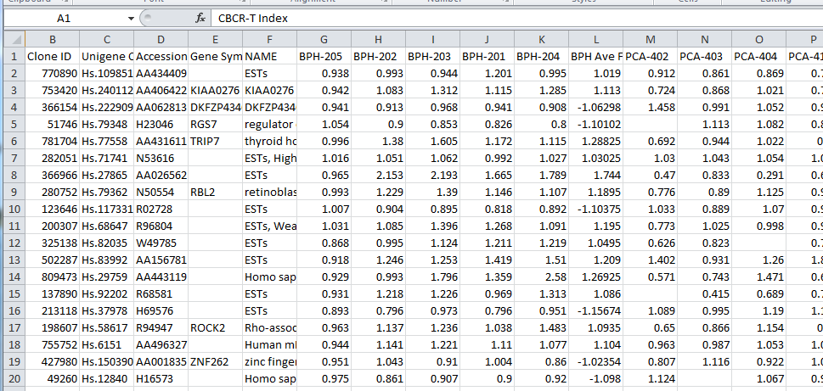
Original dataset from expression analysis
Identifiers
Measurements
Genes or molecules

Slide 20
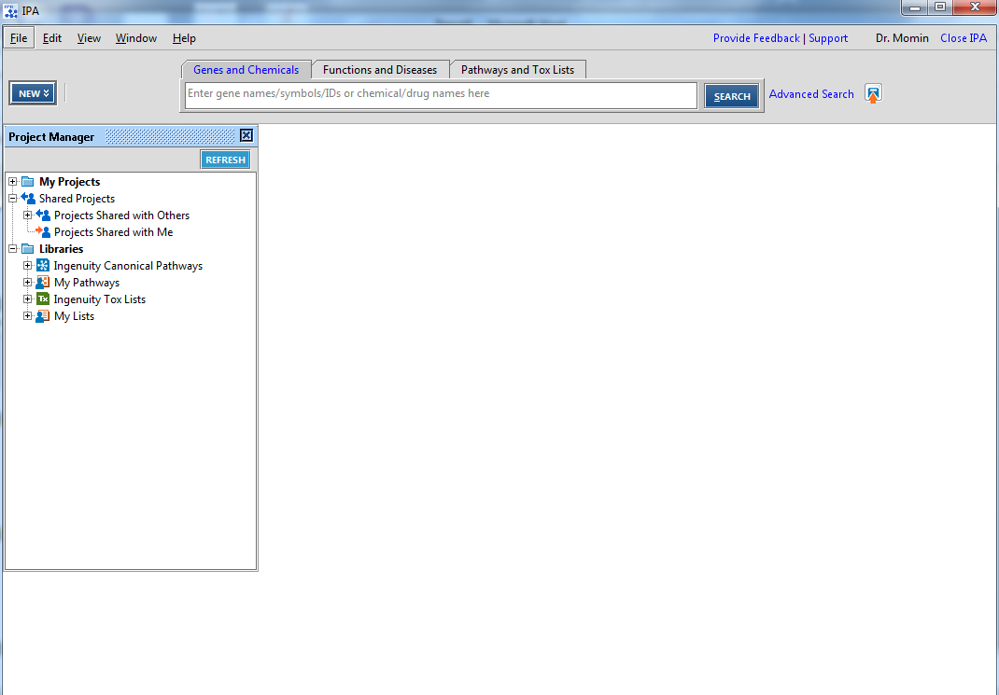
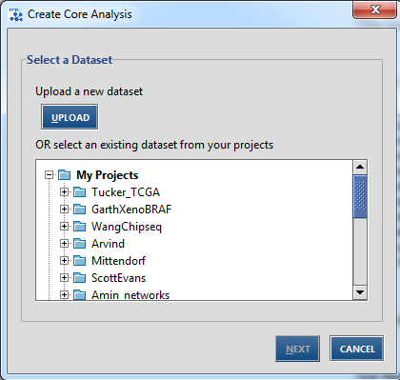
Uploading dataset
Analysis menu
Select dataset

Slide 21
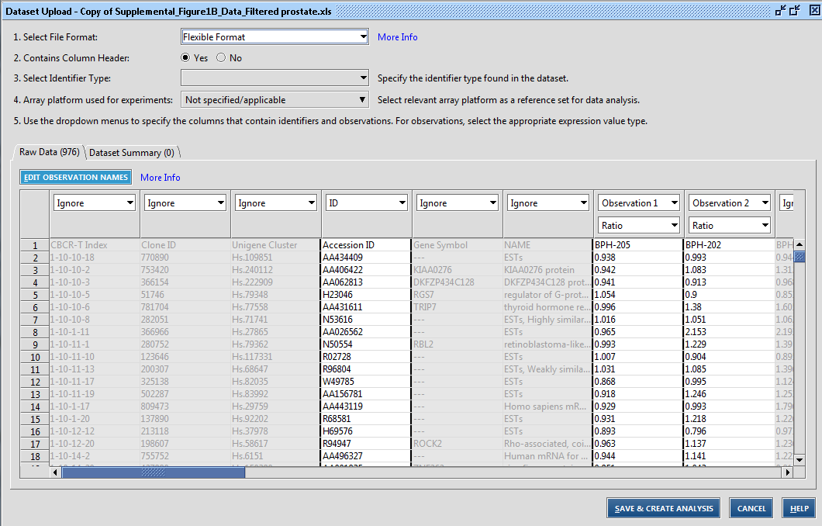
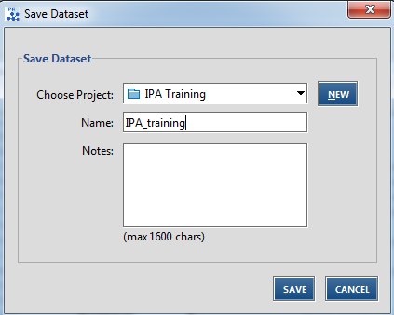
Uploading dataset

Slide 22
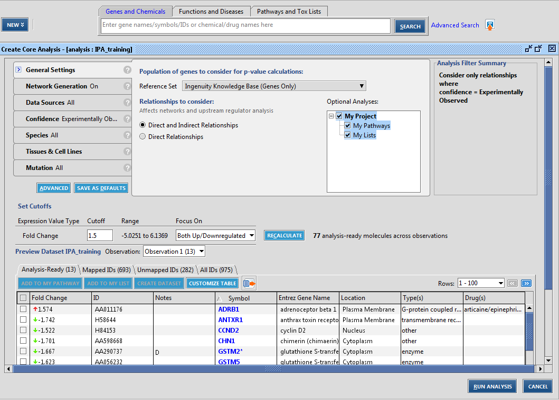
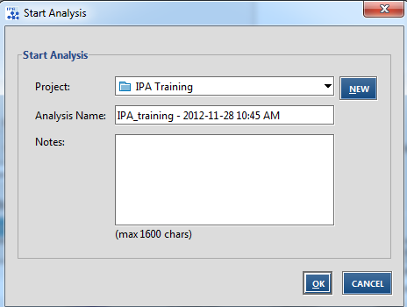
Basic core analysis

Slide 23
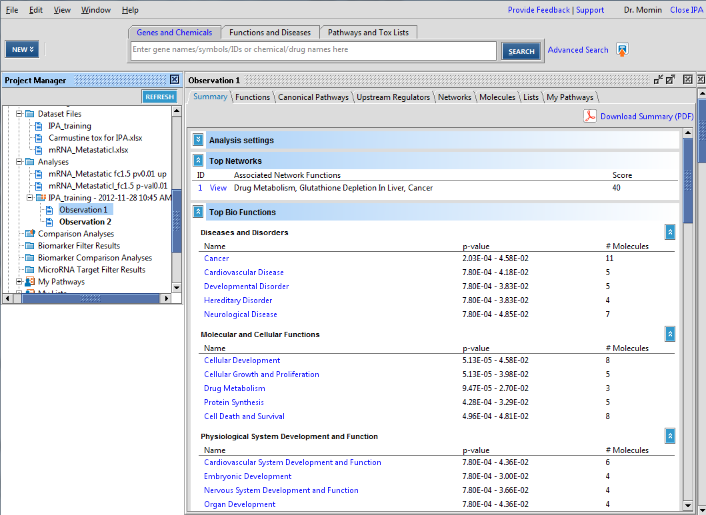
Results summary

Slide 24
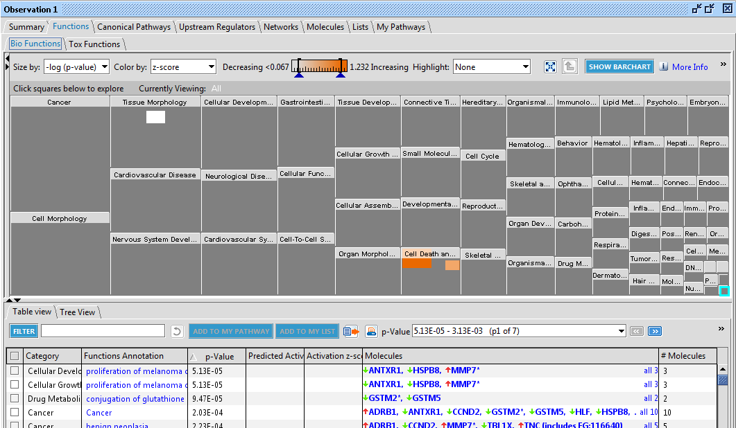
Functional enrichment

Slide 25
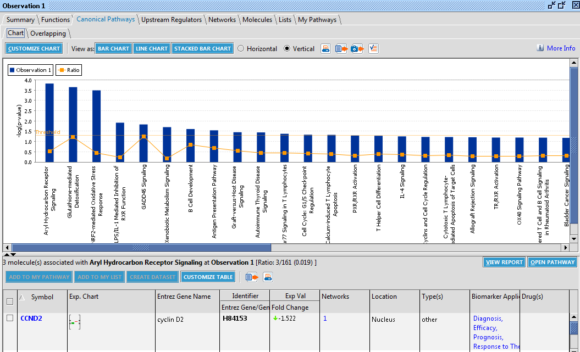
Canonical pathways (metabolic and signaling)

Slide 26
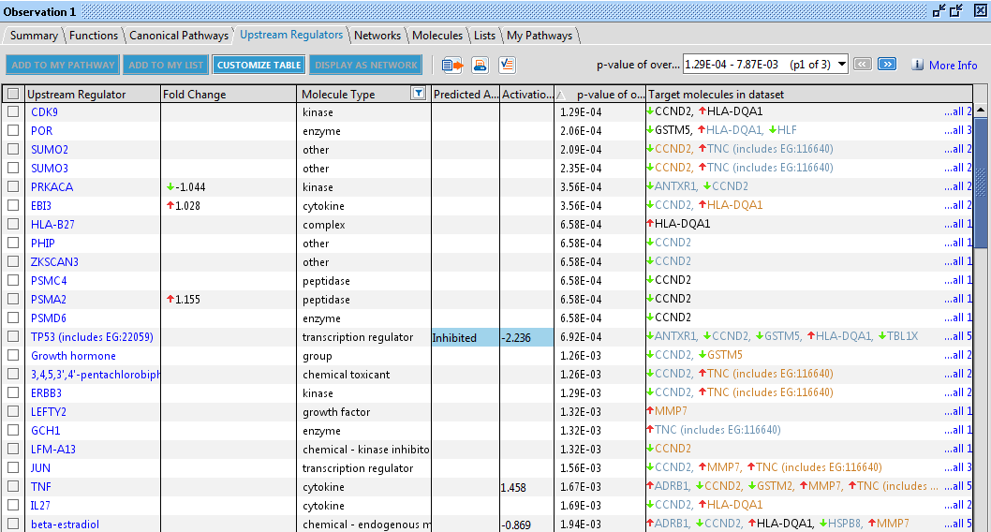
Upstream regulators (topology based pathway analysis)

Slide 27
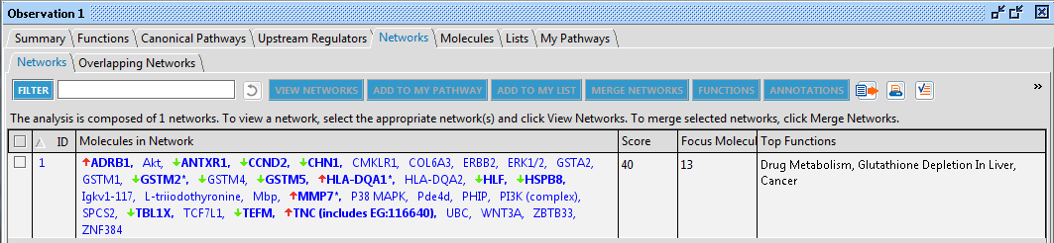
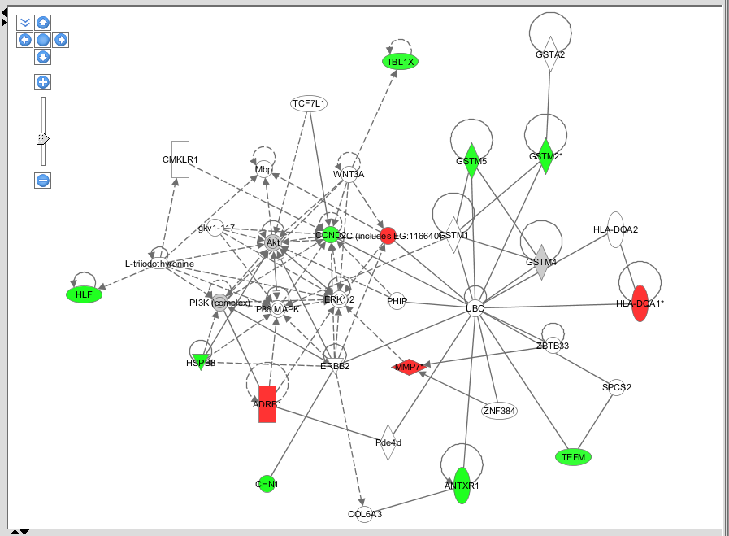
Network construction with data

Slide 28
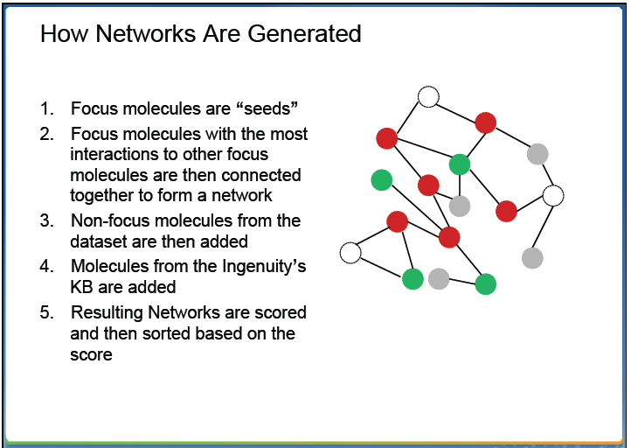
Steps in network construction
Analysis list
IPA training

Slide 29
Building custom network between genes
and molecules

Slide 30
How does one do this?
Have a clear biological hypothesis
Select the appropriate workflow/algorithm
Specify types of relationship to include:
direct, indirect
Databases to be used for edges of the network
Experimentally validated or prediction

Slide 31
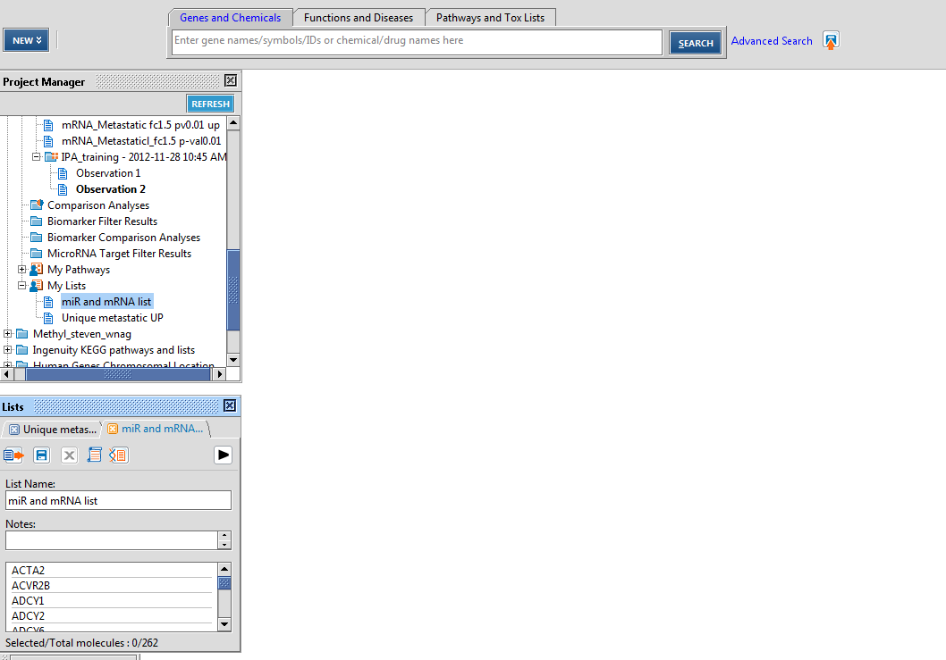
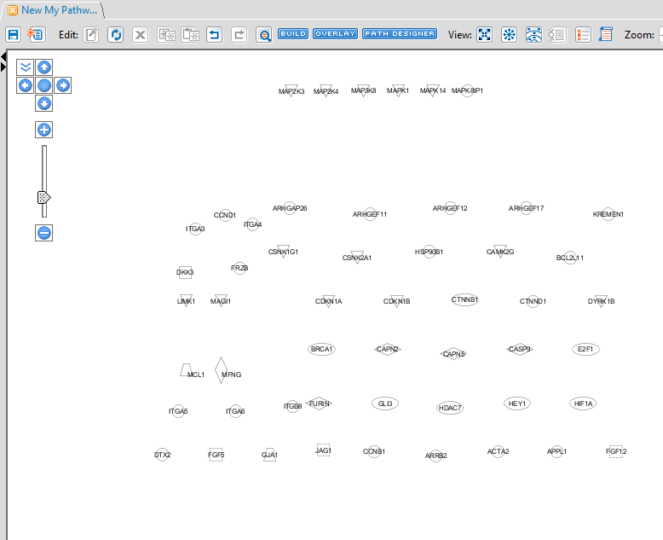
Export list of molecules into a pathway
Any kind of biological molecule having relationship within the databases

Slide 32
Window
setting
Network options
Network Layout

Slide 33
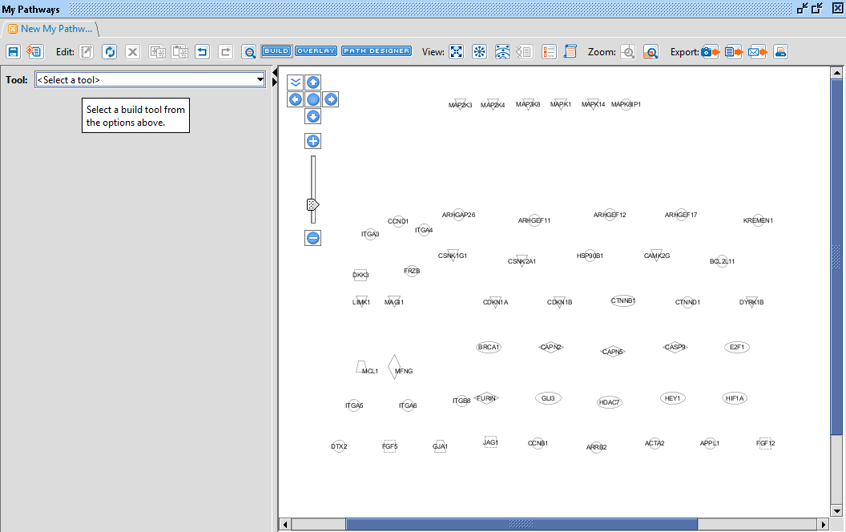
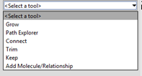
Select Network algorithm/workflow

Slide 34
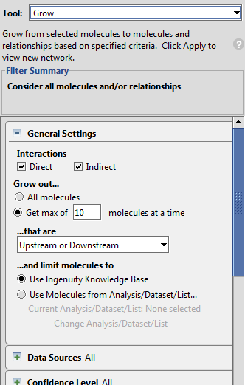
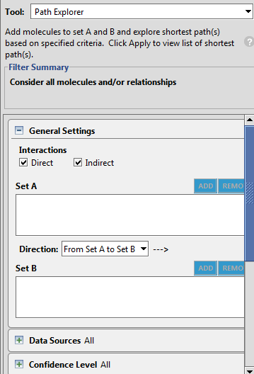
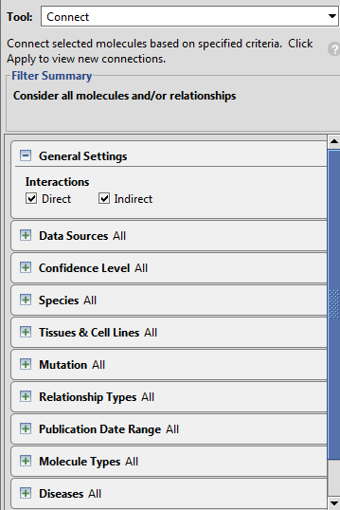
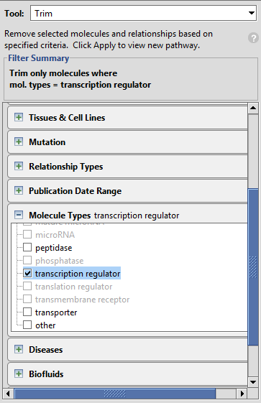
Algorithms to Build and modify networks

Slide 35
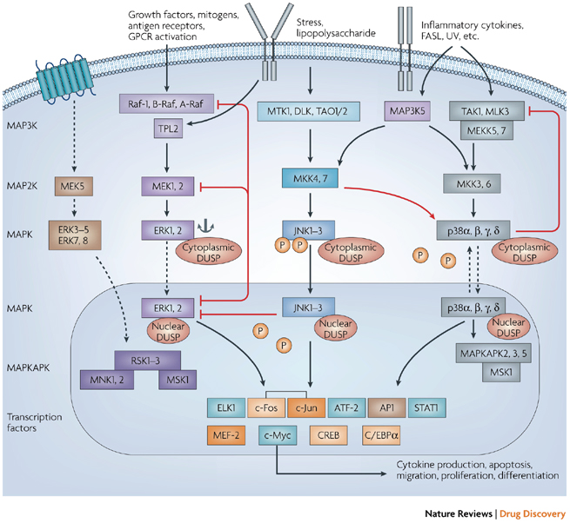
Map kinase signaling pathway
Nature Reviews Drug Discovery 6, 391-403 (May 2007)

Slide 36
What the relationship between mapk and
other genes within the list ?

Slide 37
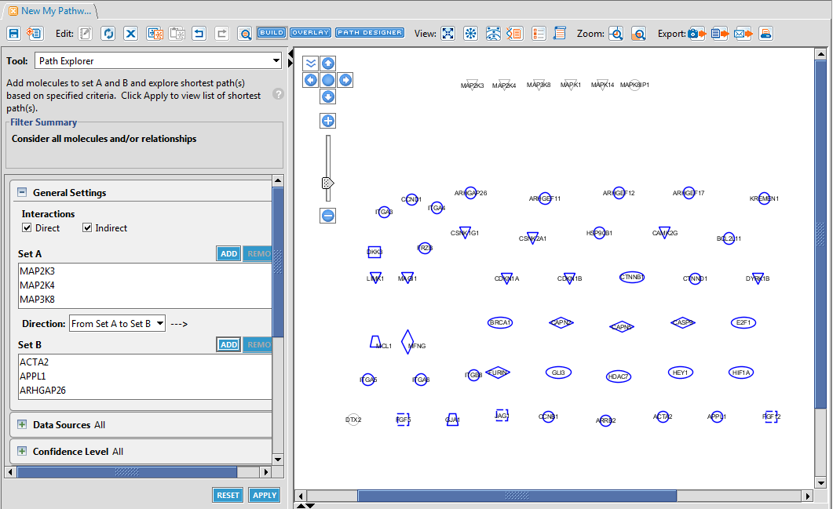
Network between Mapk and downstream targets

Slide 38
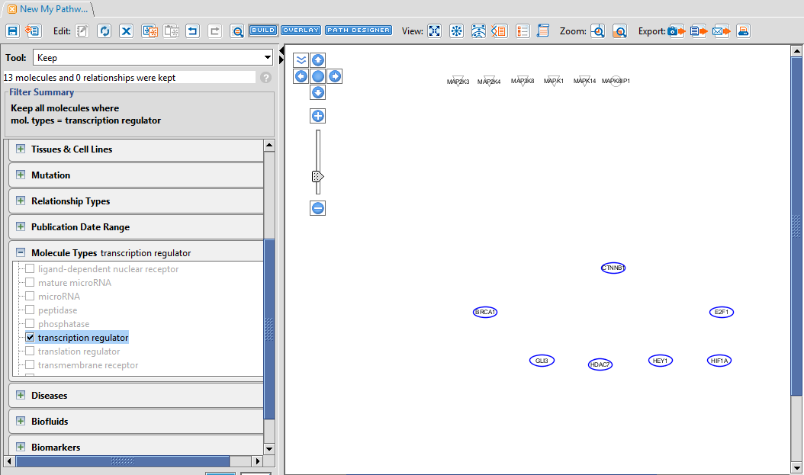
Remove non transcription factors from targets

Slide 39
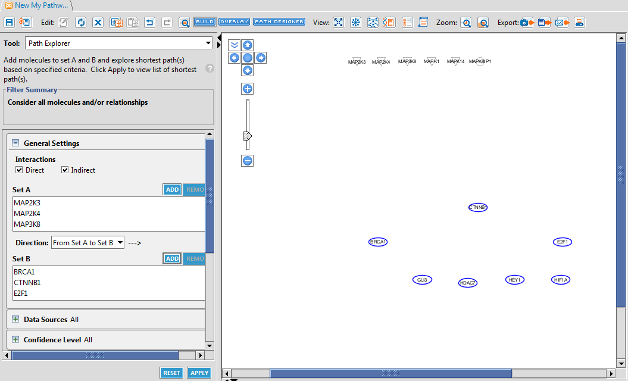
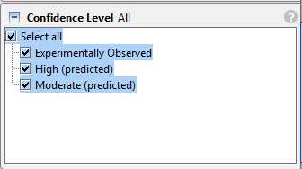
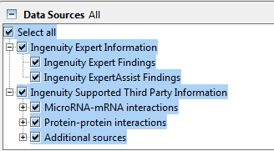
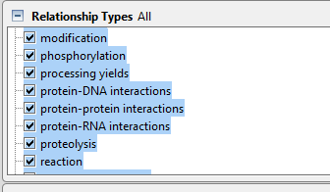
Select path explorer and specify the setting for
network construction

Slide 40
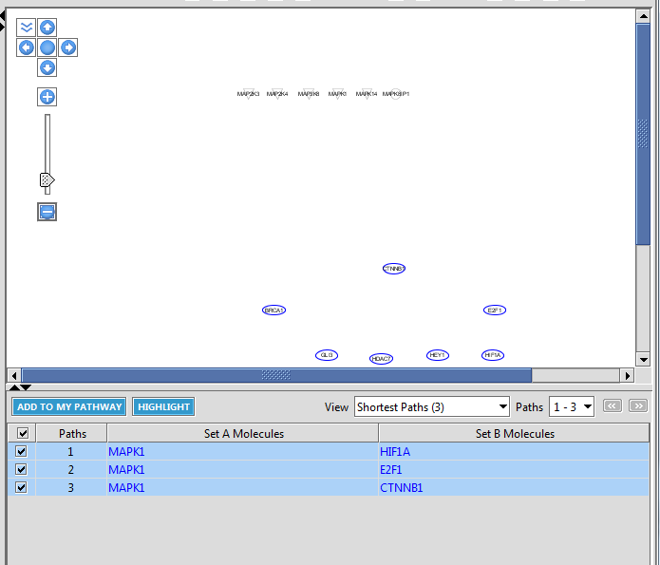

Slide 41
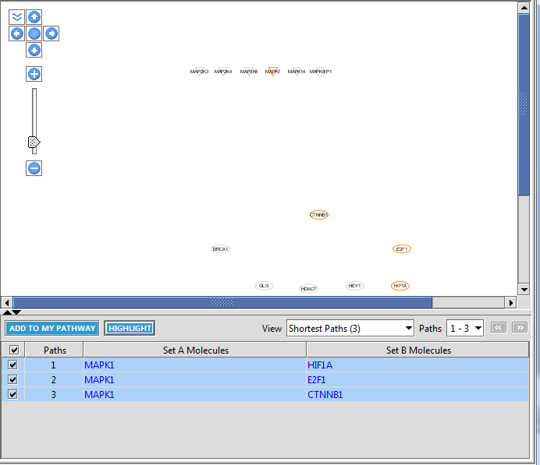
Highlight molecules with relationships on the pathway

Slide 42
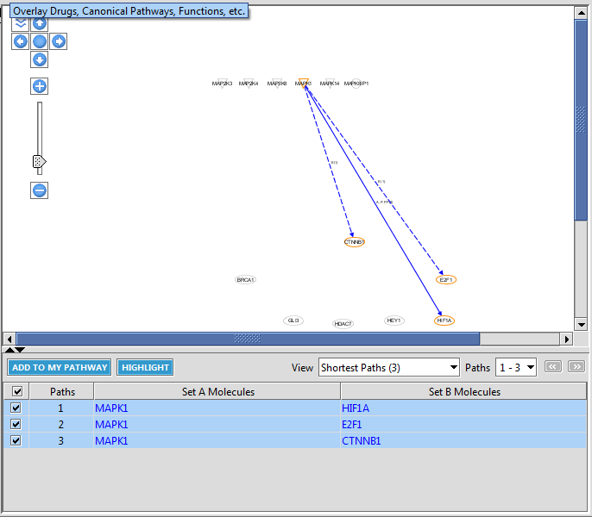
Show the relationships on the pathway

Slide 43
Hands on network construction tutorial
1) Question to address
(co-immunoprecipitation, expression correlation, TF binding)
2) Relevant data to analyze or experimental study
(Proteomic, genomic and Chip-seq)
3) Get relationships
(Use experimental data or databases/algorithms)
4) Prepare network graphs
(prepare networks using networkX, Cytoscape, etc)
5) Combine/integrate other datasets over the network
(Overlay other data using cytoscape)

Slide 44
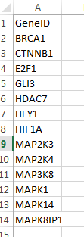
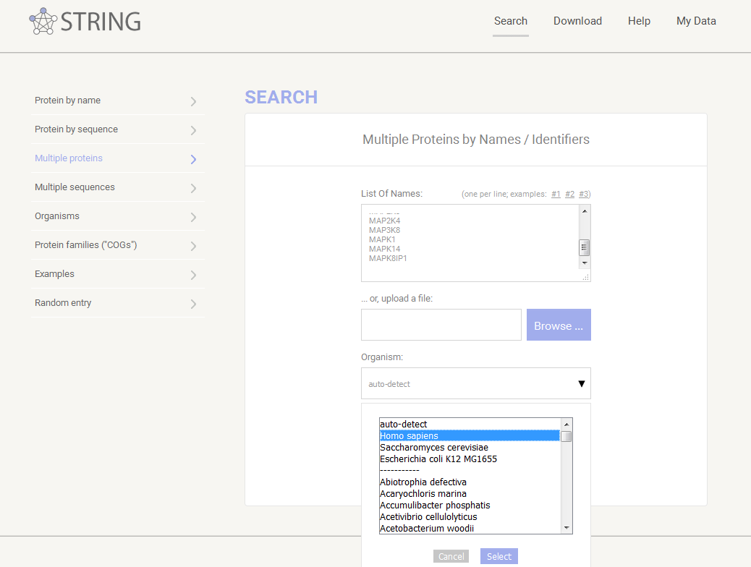
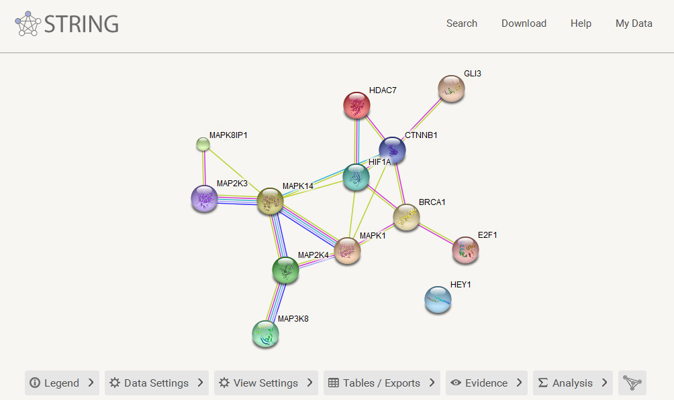
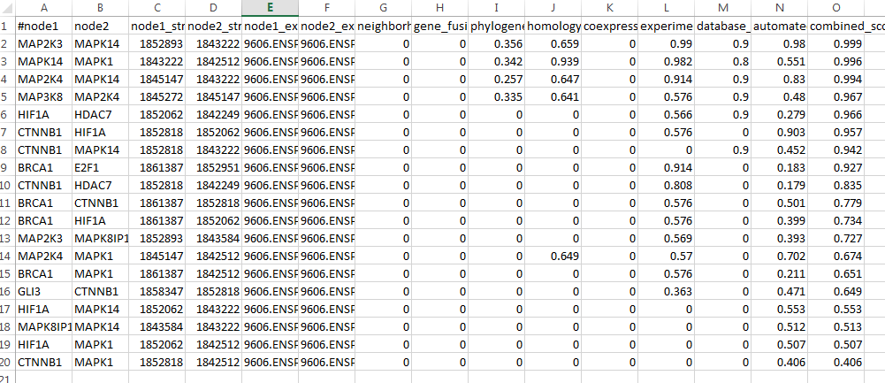
STRING DB construction of network
Export simple tabular text output

Slide 45
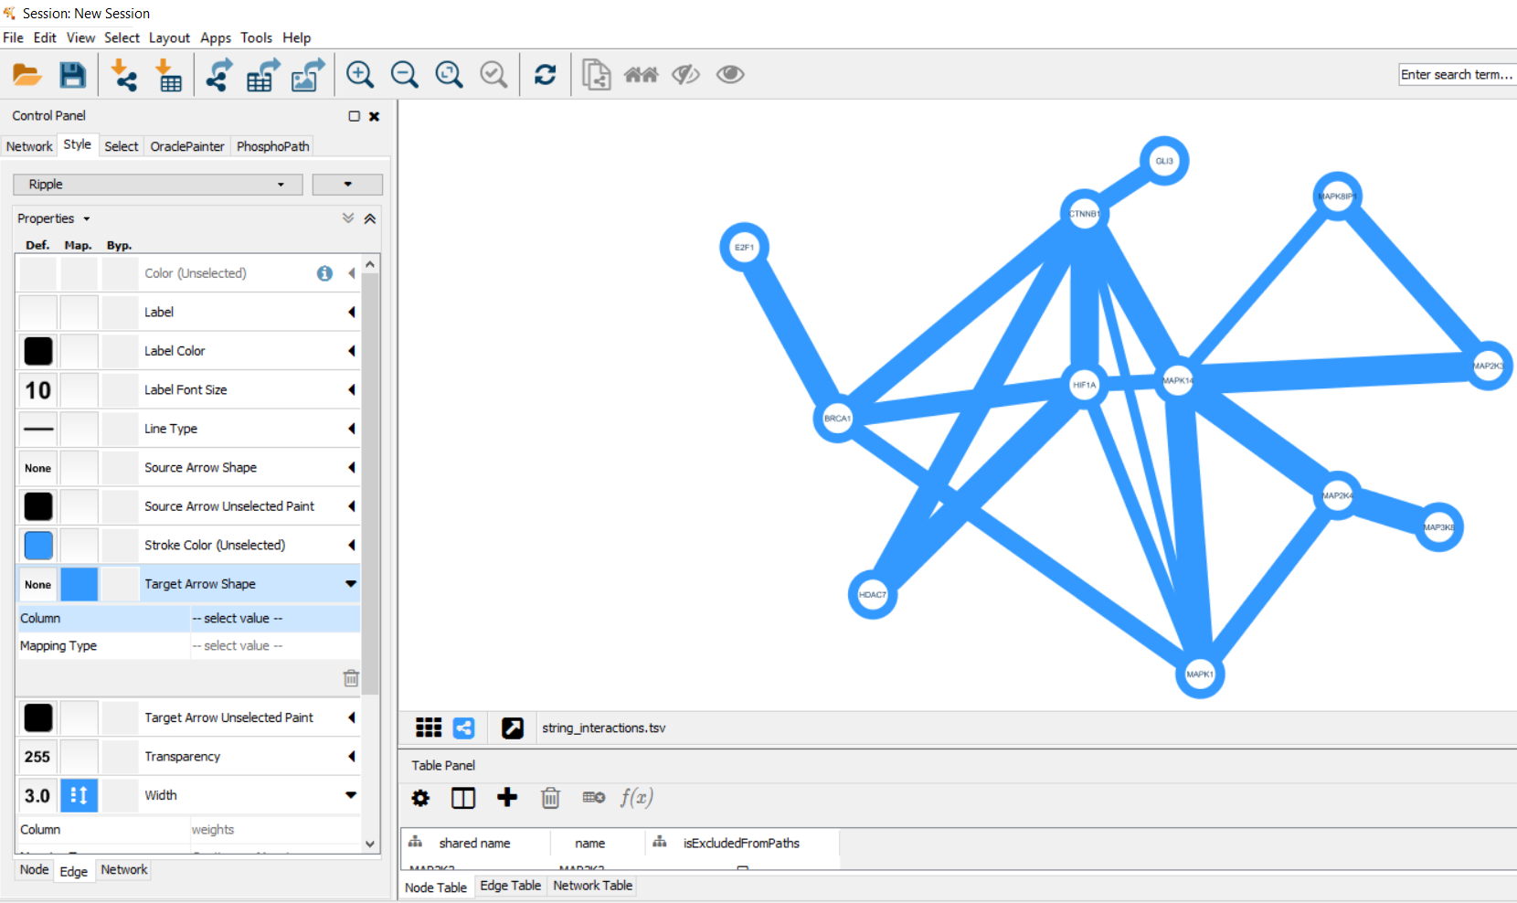
Cytoscape visualization of network

Slide 46
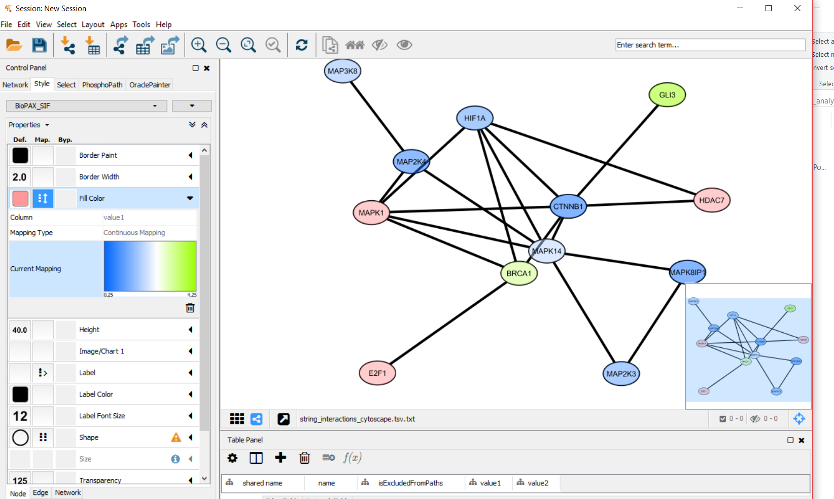
Overlay expression on network

Slide 47
Other bio-interpretation tools and approaches
Topological analysis of pathway (knowledge) information
Comparison of quantitative trends across datasets
Example: Oncomine and NextBio
Better visualization of multi dimentional data
Example: Heatmaps, CIRCOS plot, HIVE plot, graphs,
pathway overlay etc

Slide 48
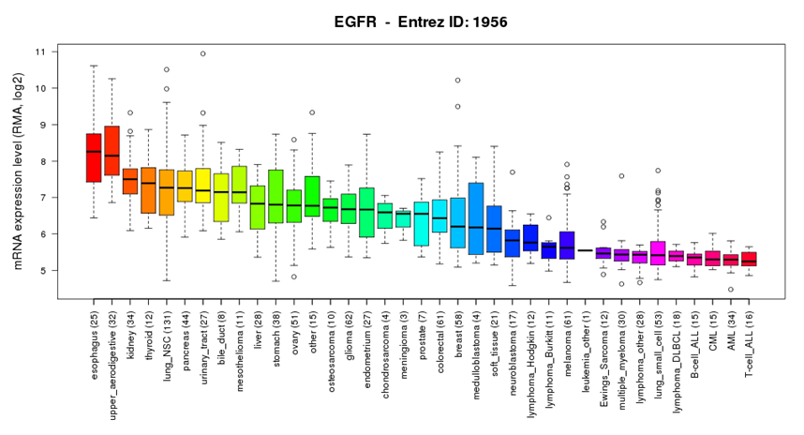


Tissue specific expression of gene and proteins
Protein Atlas
CCLE
BioGPS

Slide 49


Comparison of quantitative trends across datasets
NextBio
Oncomine

Slide 50
Thanks for attending
Acknowledgement
Ken Chen
Arvind Rao
Nick Nevin

Slide 51


Slide 52


Slide 53


Slide 54


Slide 55


Slide 56


